Slide 1
CSCI 1070 Final Project
Andrew Moritz

Slide 2
Overview
For my project, I wanted to create a model that would predict if an MLB player is or is not in the hall of fame
I started out by creating the model using only retired players and then used the model to predict which active players would be hall of famers if they retired today

Slide 3
Understanding the dataset
Any MLB hitter active or retired with over 3500 plate appearances (roughly 7 seasons) – 1765 players
Predicted variable – HOF_status – is a player active, in the hall of fame (HOF) or not in the hall of fame (not_HOF)
Data set was split into to different data frames, one for active players and one for retired players

Slide 4
Understanding the dataset - variables
G -- games played
PA -- plate appearances
HR -- Homeruns
R – Runs
RBI -- Runs Batted in
SB -- stolen bases
AVG -- batting average
OBP -- on base percentage
SLG -- Slugging percentage
wRC+ -- Weighted runs created
Off -- Offensive Value
Def -- Defensive value
WAR -- Wins above replacement

Slide 5
Data cleaning
Sorted into two separate data frames
Dropped the name column
Converted HOF_status into a binary
1 = HOF
0 = not_HOF
Dropped SB, DEF and G as they were other lowly correlated with HOF_status or had multicollinearity

Slide 6
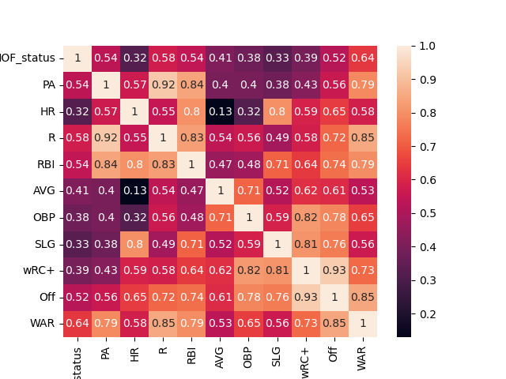
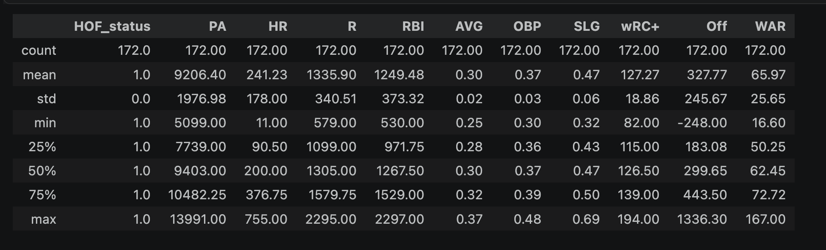

Slide 7
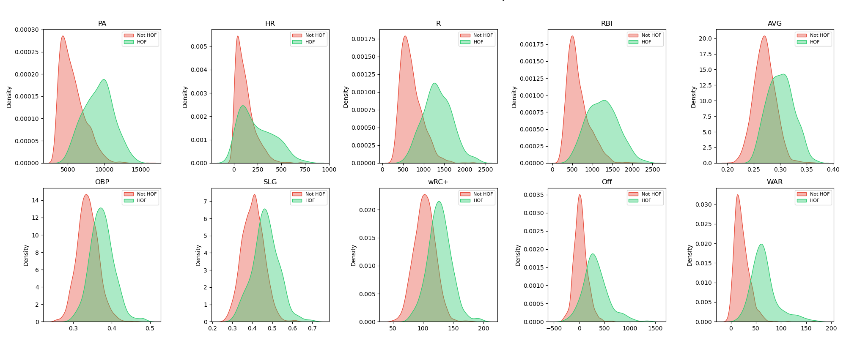

Slide 8
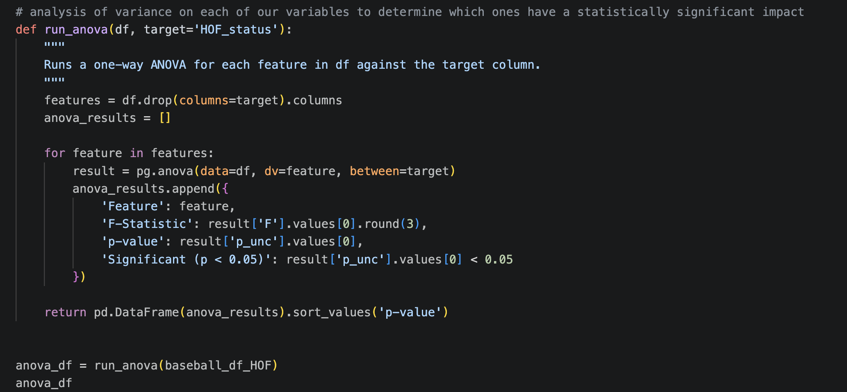
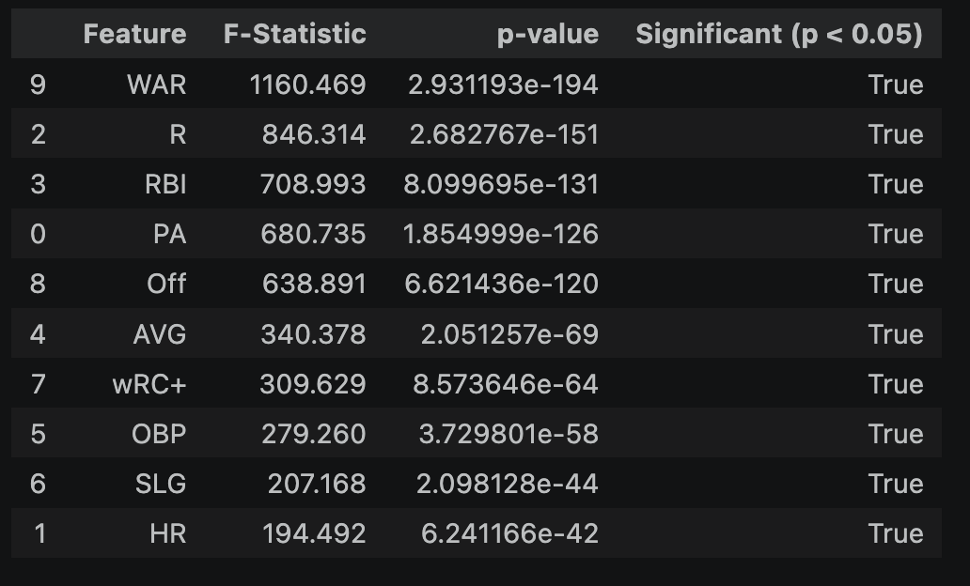

Slide 9
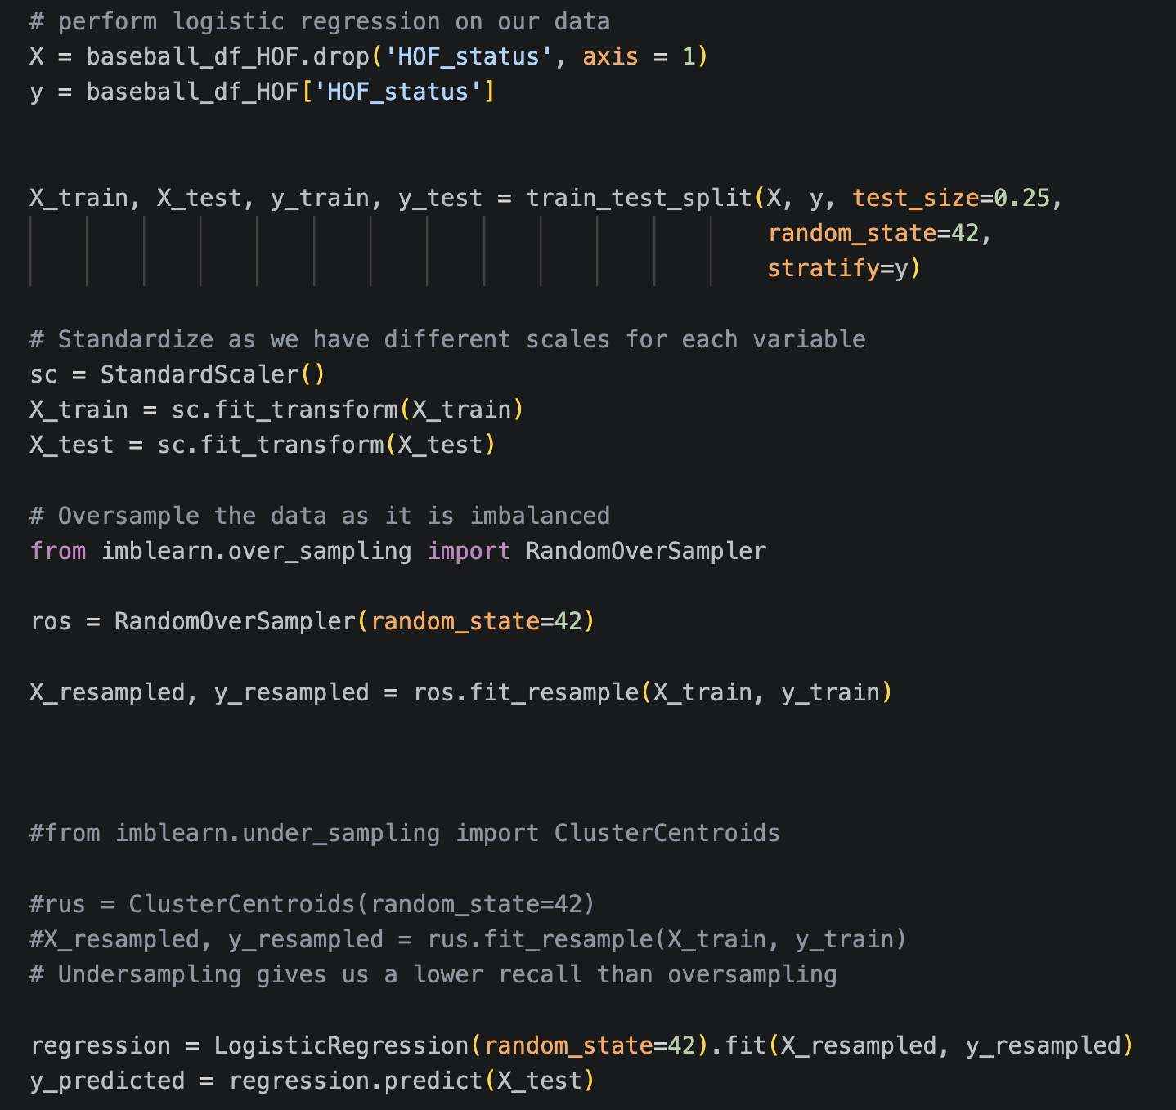
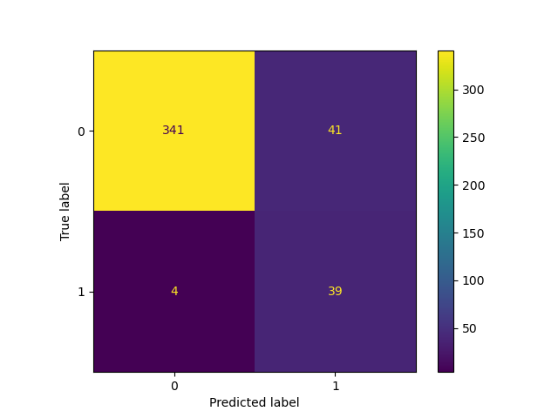
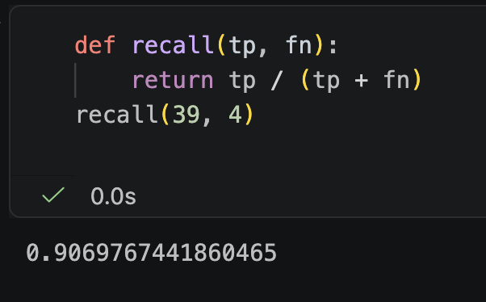
Model 1: Logistic Regression

Slide 10
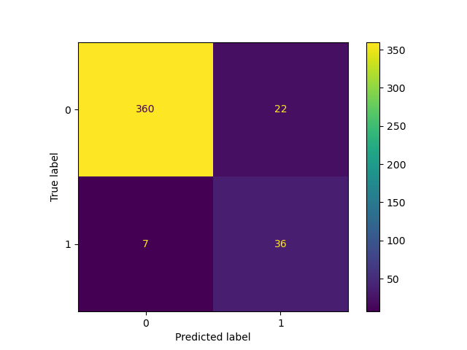
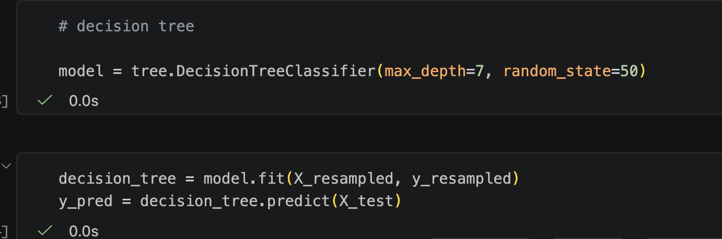
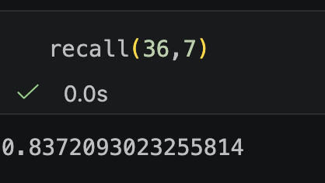
Model 2: Decision Tree

Slide 11
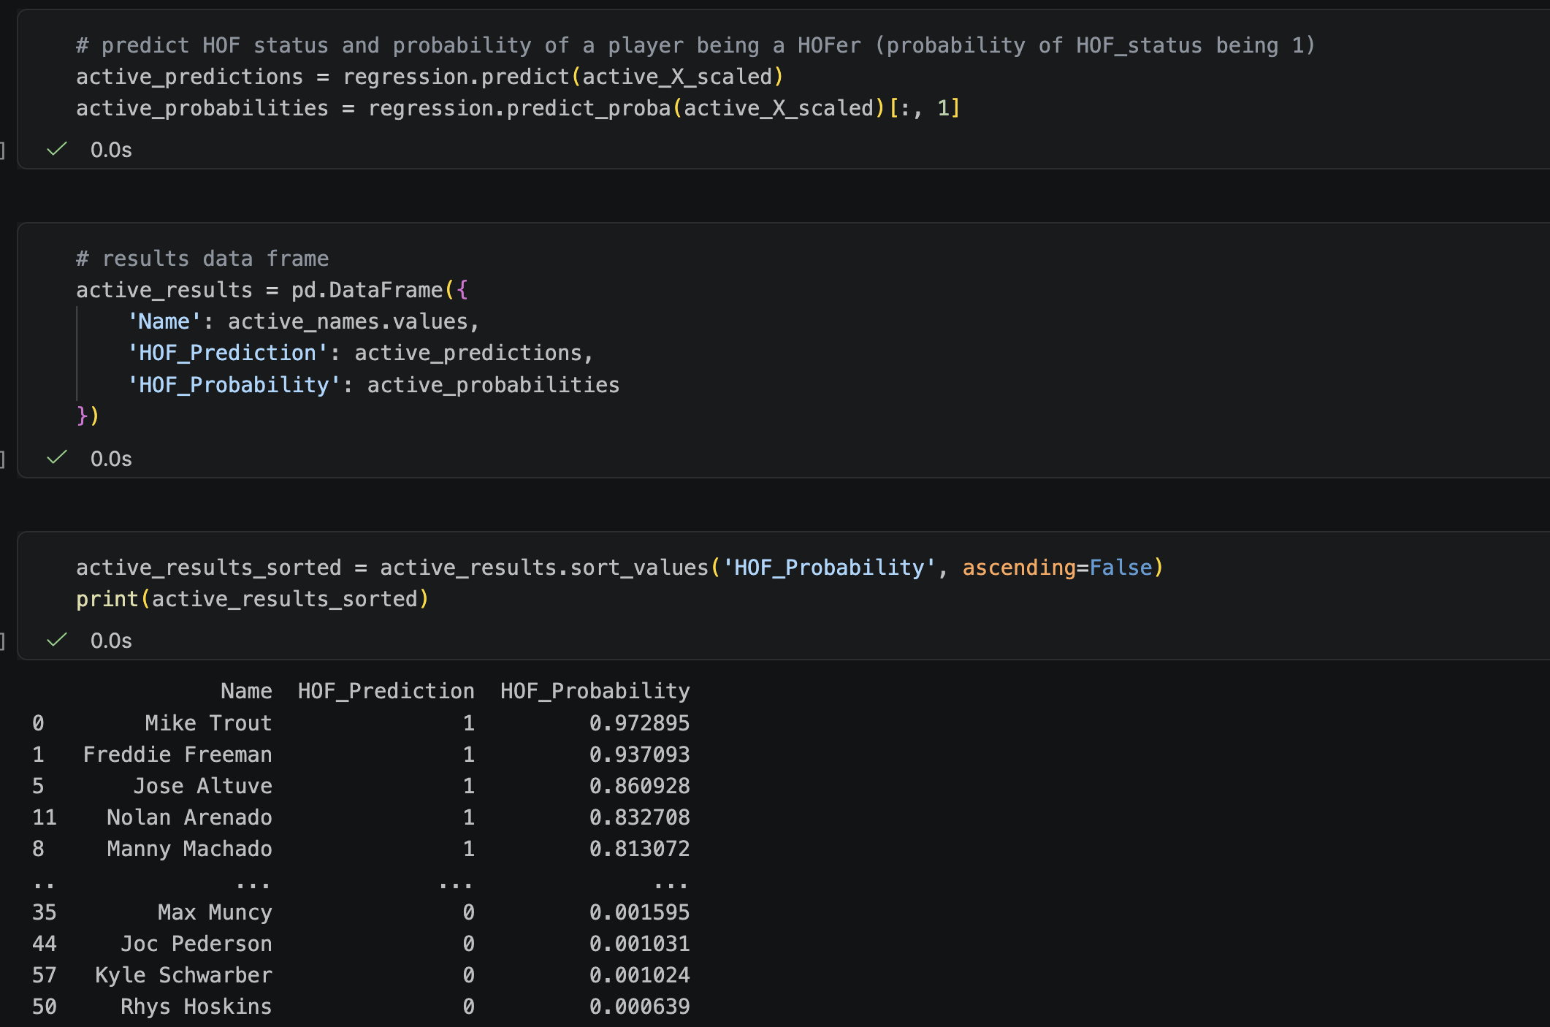
Application to active players
Similar data cleaning and preprocessing to HOF data frame
Used the logistic regression model as it had a higher recall
Used the model to both predict and give the probability that an active player would be a hall of famer

Slide 12
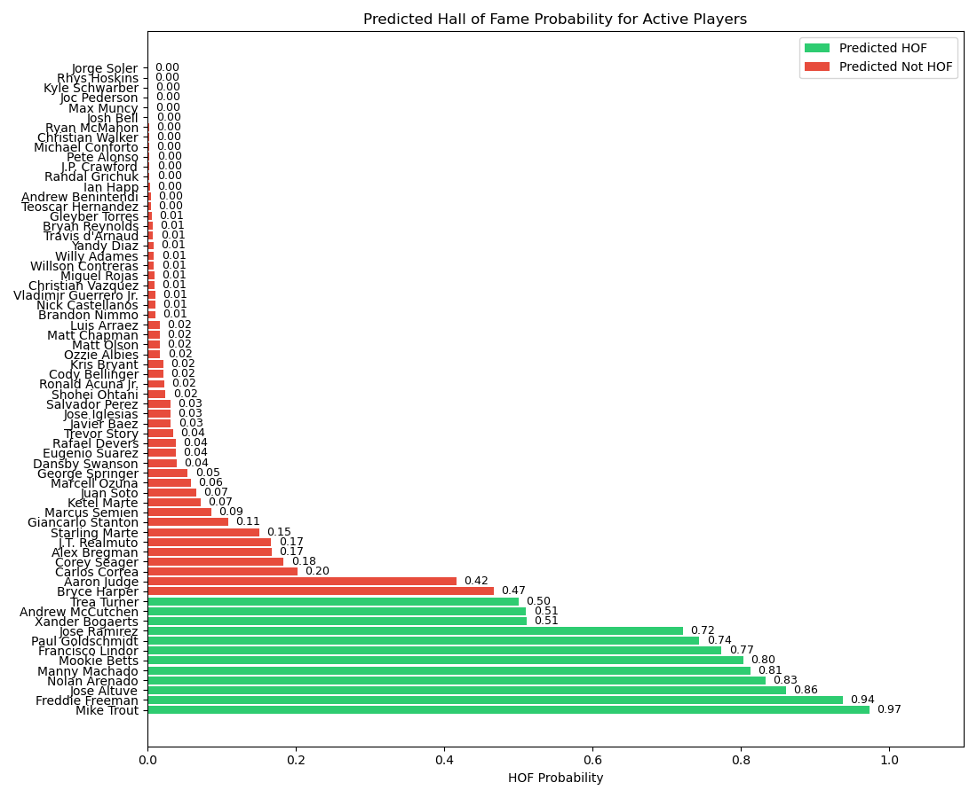

Slide 13
How did our model do
Overall, our model I think did good job of predicting which active players would be hall of famers if they retired today
However, there are a few interesting omissions as well as few players who would not be regarded as hall of fame players, most of which could potentially be attributed to insufficient data
In the next slide I will use baseball reference’s hall of fame monitor to as a comparison for our model
The hall of fame monitor is an algorithm that “attempts to assess how likely (not how deserving) an active player is to make the Hall of Fame. Using its rough scale, 100 means a good possibility and 130 is a virtual cinch” –Baseball Reference

Slide 14
Notable observations
Comparable predictions
Model says yes, HOF monitor says no
Model says no, HOF monitor says yes
Mike Trout (155 HOF monitor)
Freddie Freeman(129)
Jose Altuve (185)
Nolan Arenado (122)
Mookie Betts (122)
FPaul Goldschmidt (109)
Jose Ramirez (82)
Xander Bogaerts (65)
Andrew McCutchen (50)
Trea Turner (67)
Fransico Lindor (69)
Manny Machado (72)
Aaron Judge (164)
Shohei Ohtani (124)

Slide 15
Reasons for inconsistencies and final thoughts
Model was intentionally created to be more liberal in deciding if a player would be a hall of famer
No account taken for awards, all star appearances, world series, etc
More data would most likely lead to a more accurate model, but overall I would say our model did a good job

